Slide 2
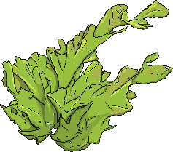
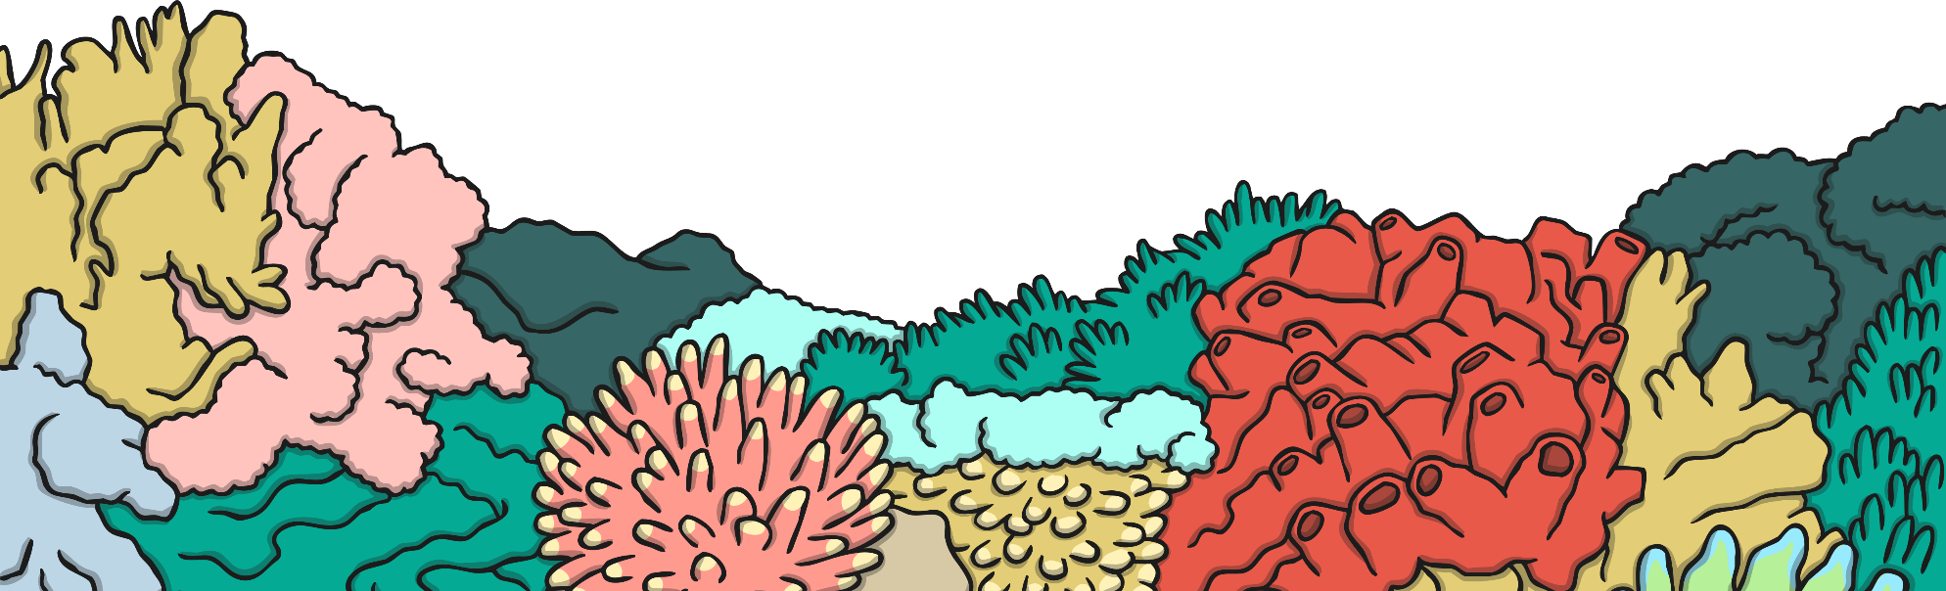
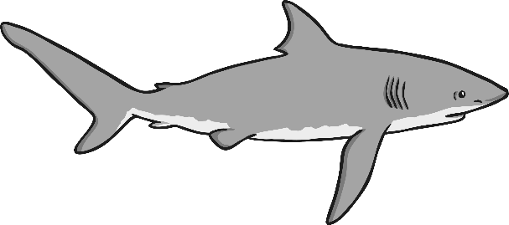
Click the seaweed for clues.
1
I have rough sharp skin.
2
I have an amazing sense of smell.
3
I am a predator of the sea.
What am I?
Reveal
I am a shark!
Next

Slide 3
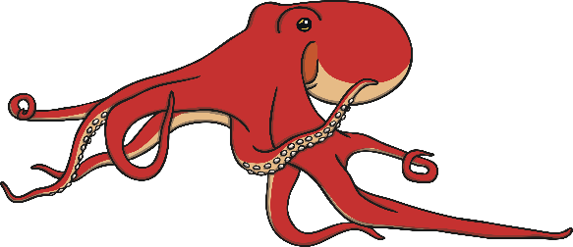
Click the seaweed for clues.
1
I am a little bit poisonous.
2
I have a great, big head.
3
I have eight legs with suckers on.
What am I?
Reveal
I am a octopus!
Next

Slide 4
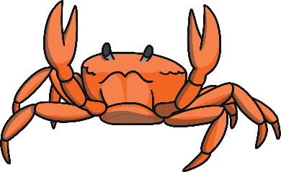
Click the seaweed for clues.
1
I have 10 legs.
2
I have a hard shell.
3
I have sharp pincers.
What am I?
Reveal
I am a crab!
Next

Slide 5
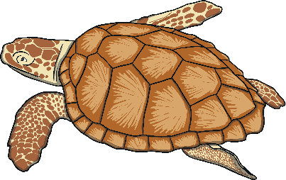
Click the seaweed for clues.
1
I have 4 flippers.
2
I have cousins that live on land.
3
I have a shell that protects me.
What am I?
Reveal
I am a turtle!
Next

Slide 6
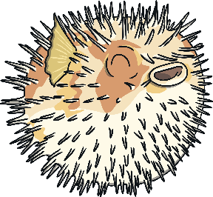
Click the seaweed for clues.
1
I look harmless but I am very poisonous.
2
Some people in Japan like to eat me.
3
I can blow myself up to be twice as big when I am in danger.
What am I?
Reveal
I am a pufferfish!
Next

Slide 7
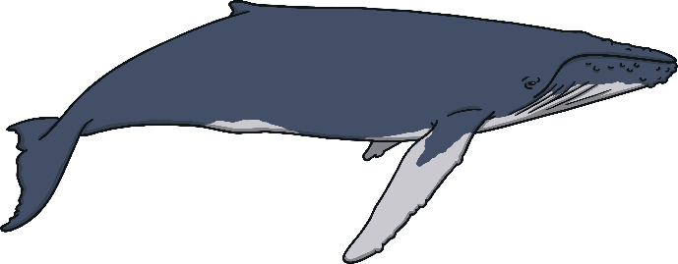
Click the seaweed for clues.
1
I am a mammal.
2
I have a blowhole.
3
I can grow to be very big.
What am I?
Reveal
I am a whale!
Next

Slide 8
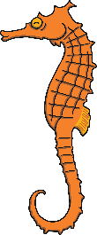
Click the seaweed for clues.
1
The males of my species become pregnant.
2
I am an endangered animal.
3
I am a fish but there is a different animal in my name.
What am I?
Reveal
I am a seahorse!
Next

Slide 9
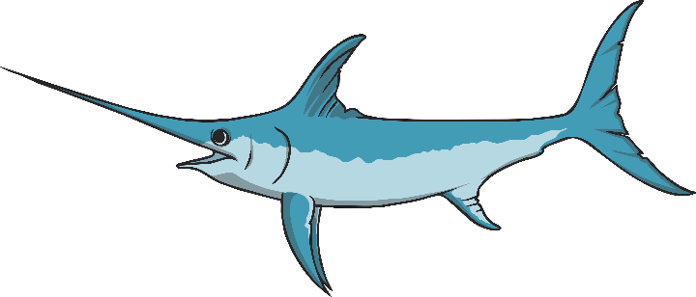
Click the seaweed for clues.
1
I have a very long and sharp nose.
2
I am one of the fastest swimmers in the ocean.
3
I am most active at night.
What am I?
Reveal
I am a swordfish!
Next

Slide 10
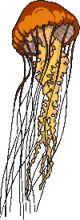
Click the seaweed for clues.
1
I can be lots of different sizes.
2
I have no brain.
3
I can change colour and I might look see-through.
What am I?
Reveal
I am a jellyfish!
Next

Slide 11
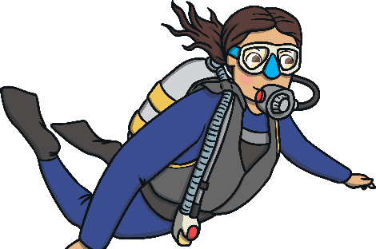
Click the seaweed for clues.
1
I am a mammal.
2
I need special equipment to breath underwater
3
I live on the land.
What am I?
Reveal
I am a human!
Next

