Slide 1

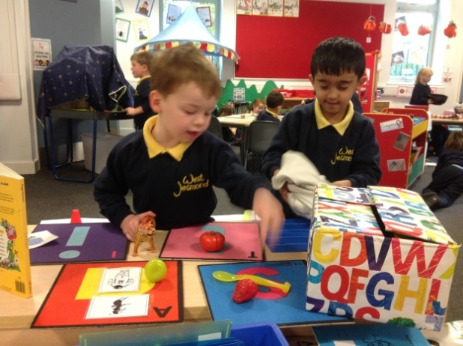
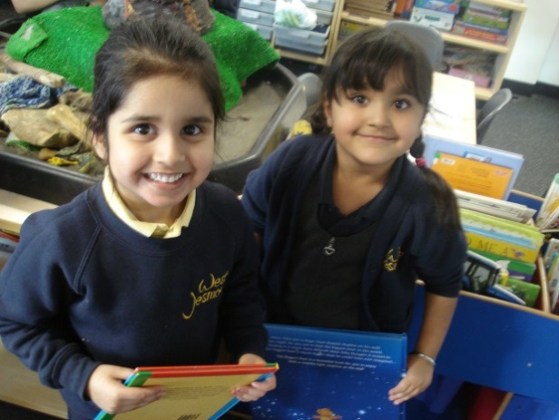
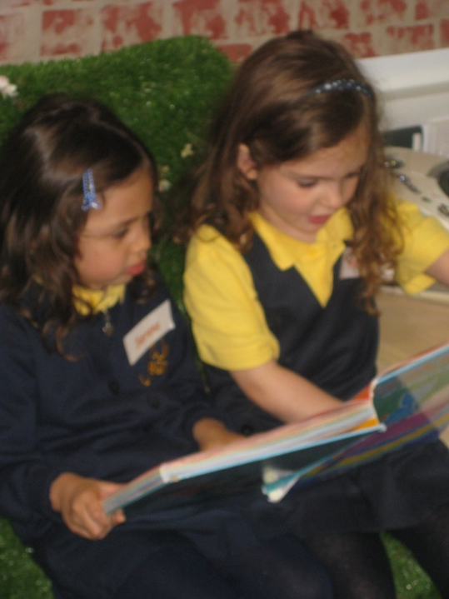
Phonics Workshop
September 2025

Slide 2
Aims of the workshop
Give an overview of ‘What is phonics?”
Explain how we approach phonics at West Jesmond
Discuss how we support children’s reading
Talk through the homework and reading pack that will be coming home
Give ideas and tips for how you can help at home
Support materials
Dates for your diary

Slide 3
What is phonics?
Learning the letter sounds
Learning letter formation
Learning helpful /tricky words
Learning to blend sounds together
Learning to identify sounds in words

Slide 4

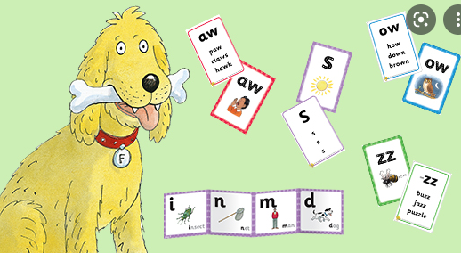
How do we teach reading?
Floppy’s Phonics
High frequency words/Helpful Words
Shared reading
Individual Reading and Guided Reading
Speaking and listening

Slide 5

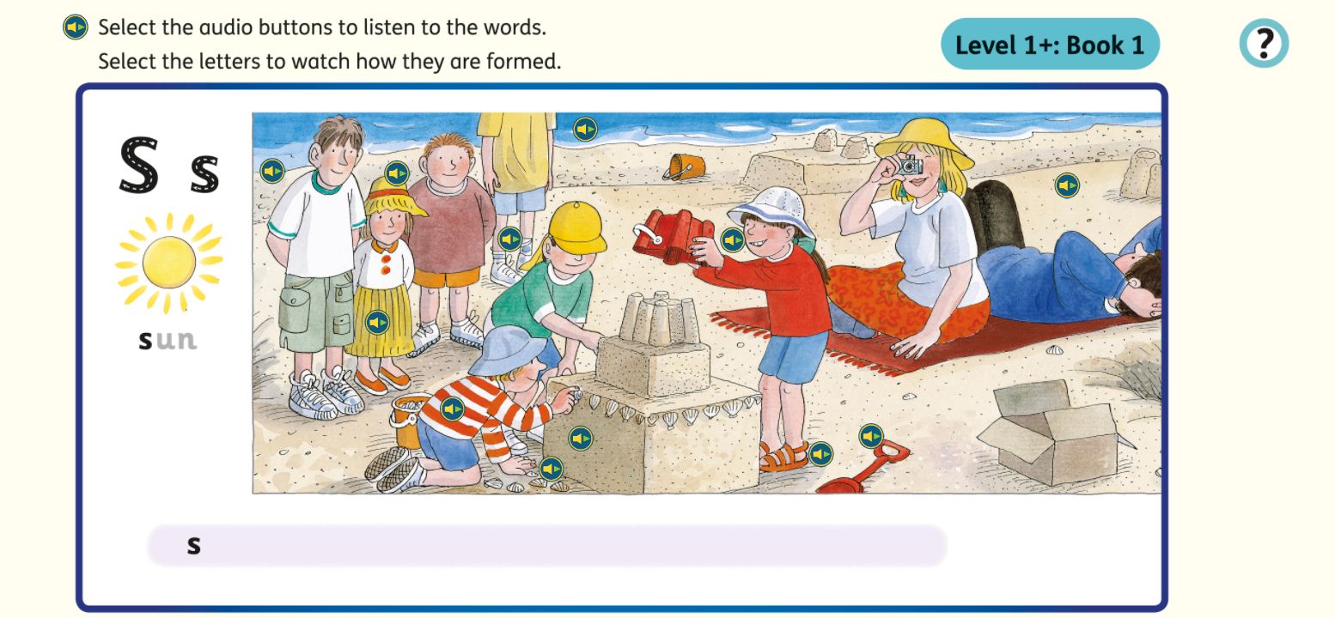

Learning the letter sounds sounds

Slide 6
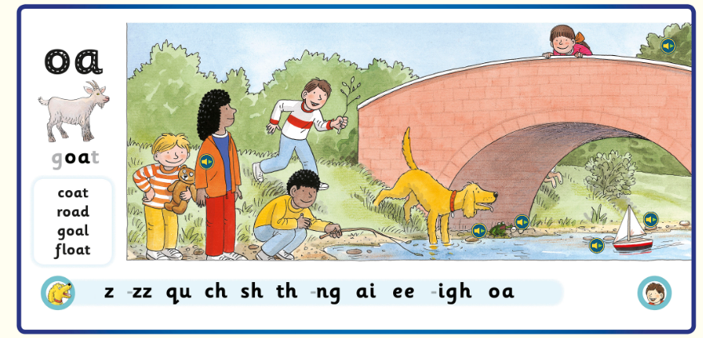

Slide 7
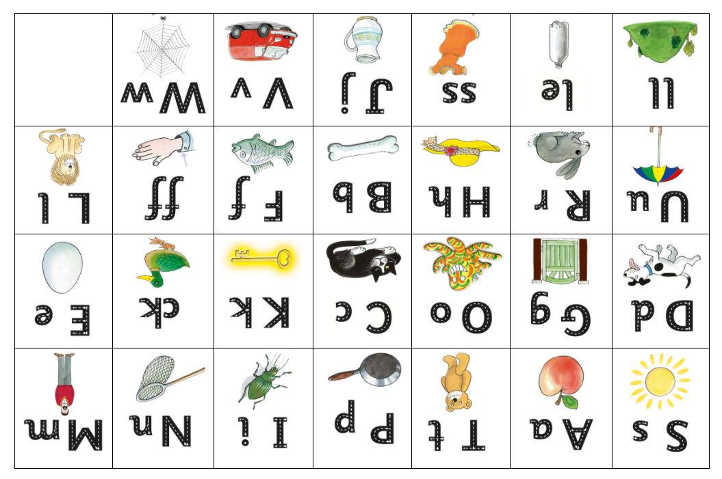

Sounds taught in Level 1

Slide 8
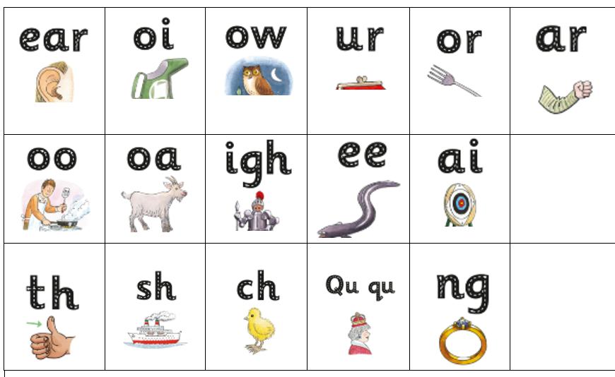
Sounds taught in level 2

Slide 9
s a t i p n
Learning to blend sounds together
Real words:
sat
tin
pat
at
it
Nonsense words:
ta
pi
nat
sa
ip

Slide 10
Building on initial skills……
pan
sad
top
bed
egg
huff
duck
ship
rain
hoot
sheep
fork

Slide 11
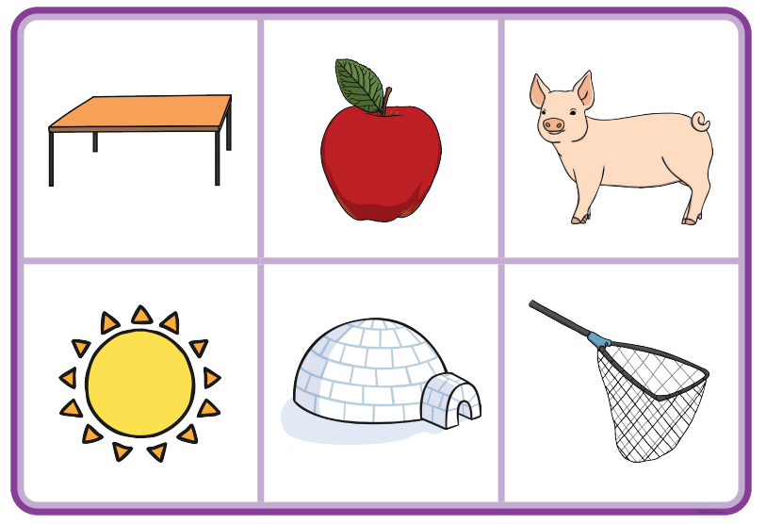
Learning to identify sounds in words –
can you “sound out” these words into their sounds?

Slide 12
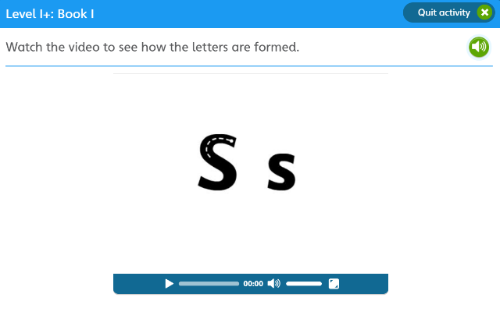
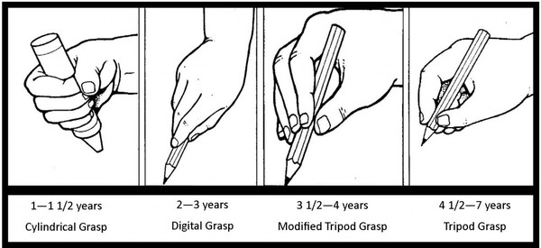
Learning letter formation
Learning how to form a letter (or group of letters) allows children to represent the sounds they hear in words correctly.
Holding a pen or a pencil needs considerable co-ordination and practice, so any large and small scale movements children can do to develop their muscle skill is a great help.
We will teach capital letters alongside lowercase, but as most letters are in lower case, it would be useful to use these at home. A good starting point is for your child to write their name correctly, starting with a capital letter, followed by lowercase letters.

Slide 13
a b c d e f g h I j k l m n o p q r s t u v w x y z

Slide 14
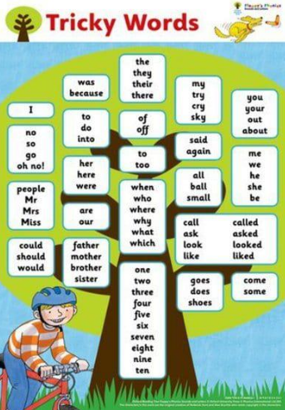
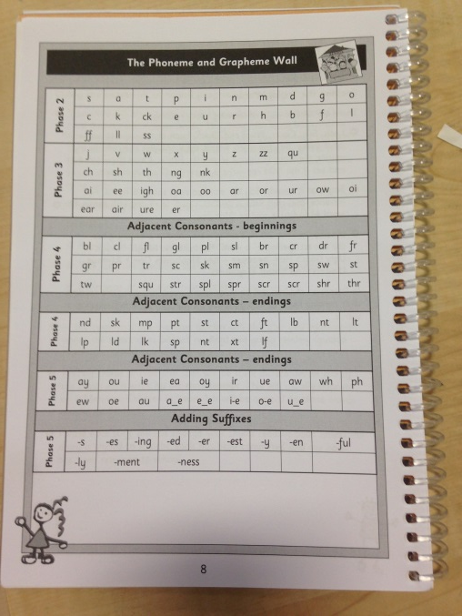
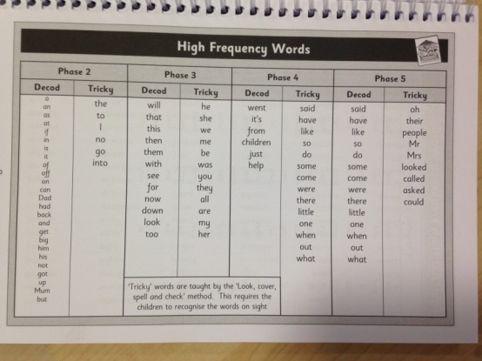
Learning Helpful/tricky words
Decodable; it in and can
Non-decodable; the is no go

Slide 15
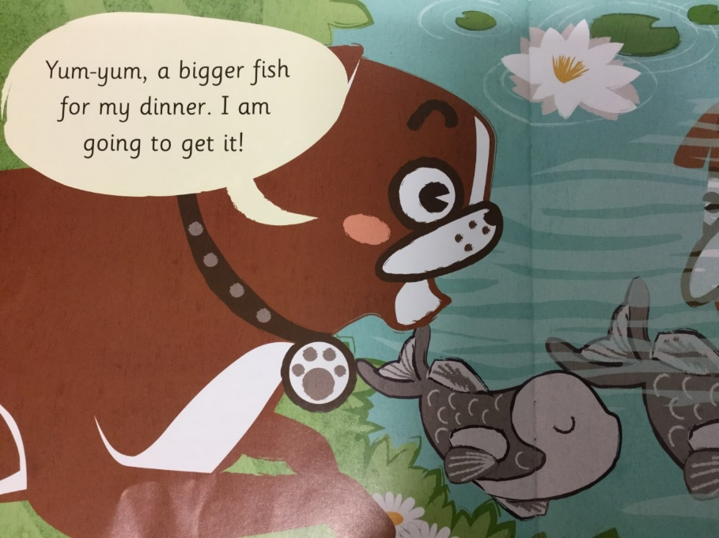
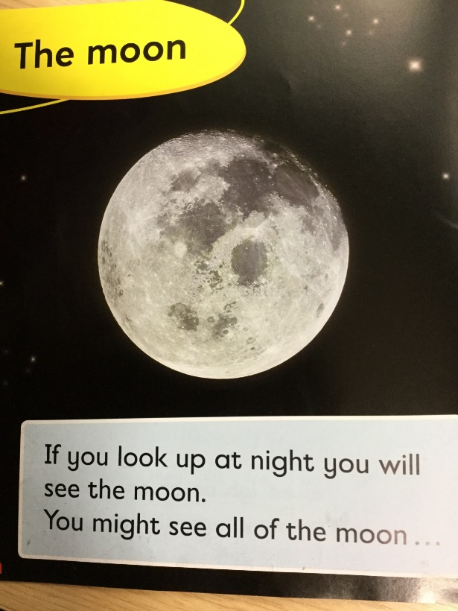
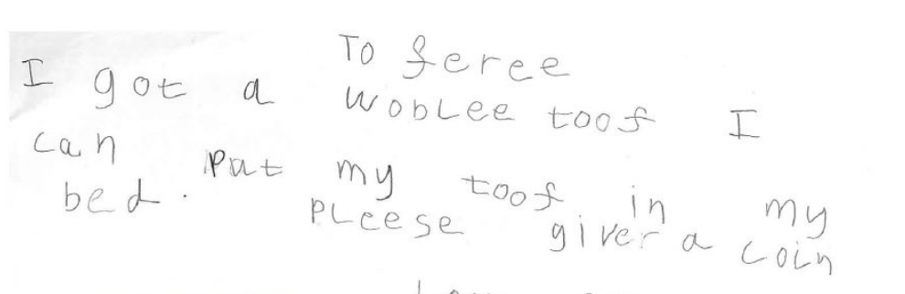
How does this all fit together?

Slide 16
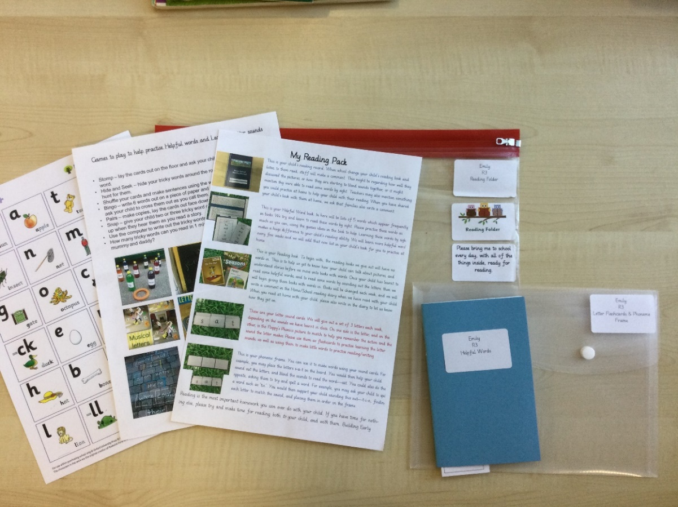
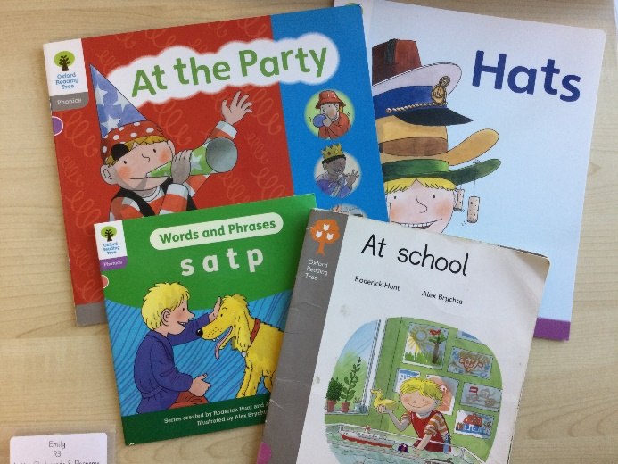
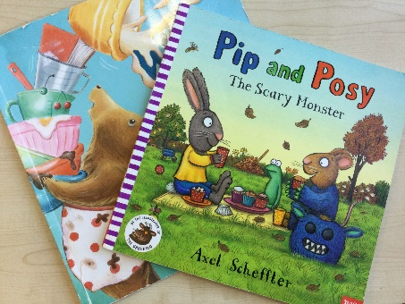
Books we send home; Explaining our reading pack
Children will be allocated a specific reading day and will be read with on that day each week. This is the day we will change their reading book and their library book and add new helpful word lists if they are ready. Please return the reading pack on that day. When you listen to your child read at home, we ask that you write a short comment in the reading diary.

Slide 17
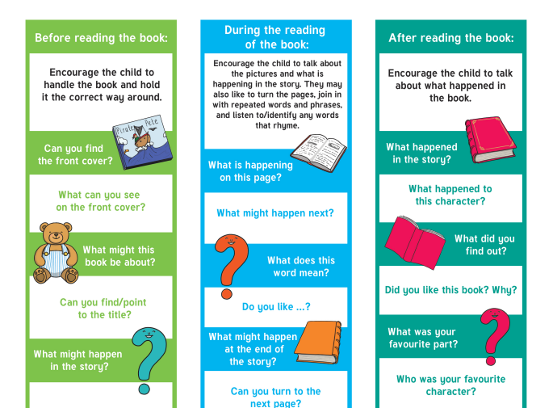
Reading Together

Slide 18
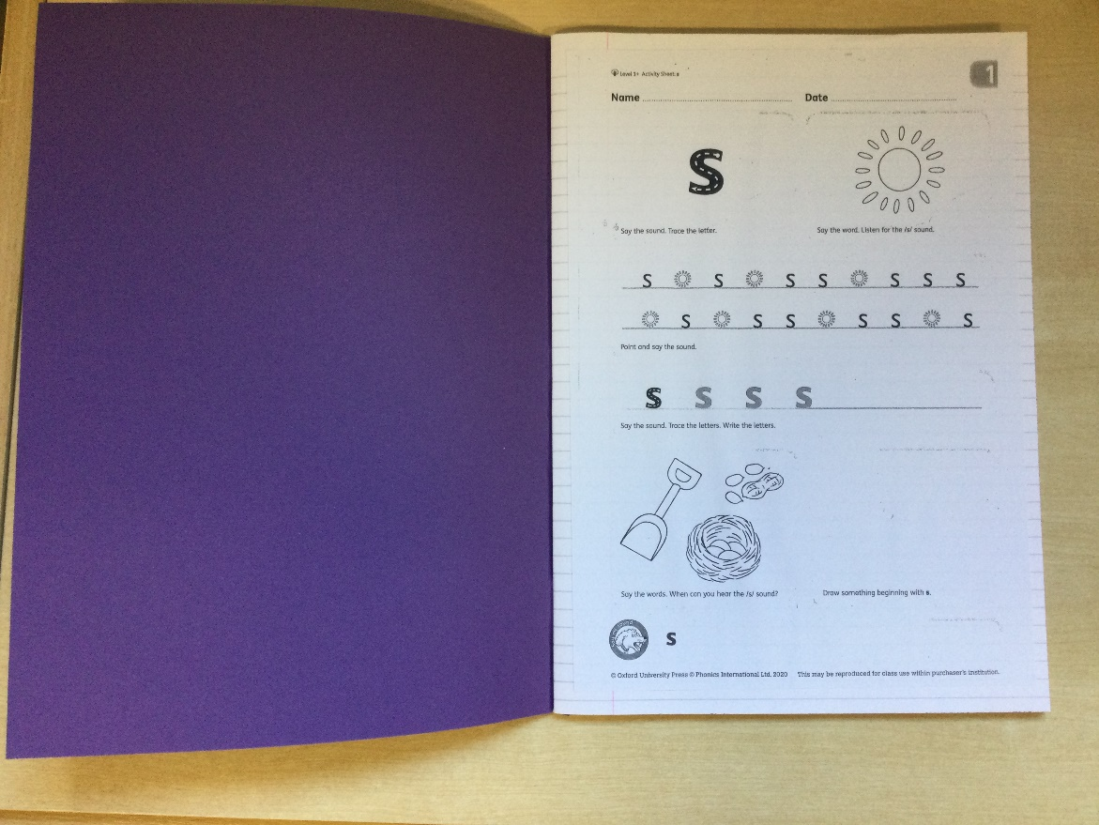

Phonics Homework
Homework will come home on a Wednesday night (once we have learnt the sounds for that week), and will contain two worksheets matching the sounds learnt in class. Please complete the sheets alongside your child and return the book no later than the following Monday. Please can we ask that you complete the worksheet in pencil.

Slide 19

Supporting your child at home with phonics:
Magnetic letters
Flashcards and blending
Practise sound-talking and asking them to blend
Look for sounds in books as you read
I-spy
Websites/apps, such as
Phonicsplay or appTeach your monster to read

Slide 20
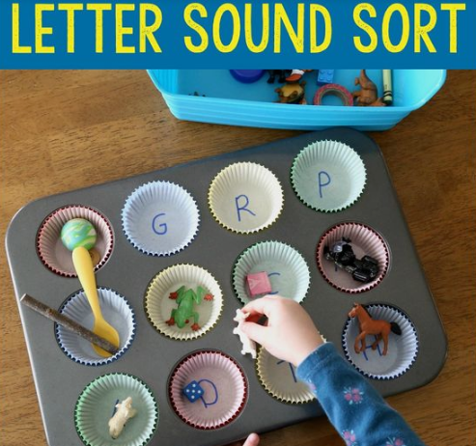
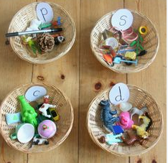
Write a sound inside a muffin case – challenge your child to find a small object that begins with that sound.

Slide 21
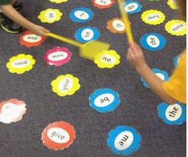
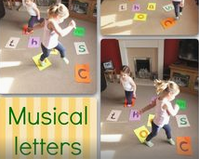
Use fly swatters to ‘swat’ the sound/word you shout out
Just like musical statues – place words or sounds on the floor, ask the children to dance until the music stops – what did they stop on?

Slide 22
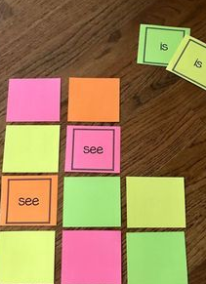

Make a simple pairs game of Helpful Words, or you could even use sound cards.

Slide 23
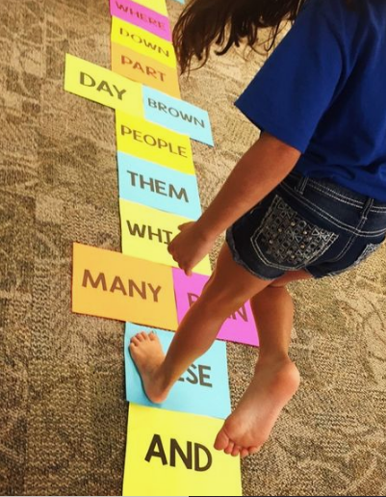
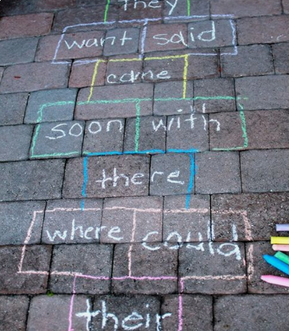
Write helpful words or simple words on the ground/on card and play hopscotch.

Slide 24
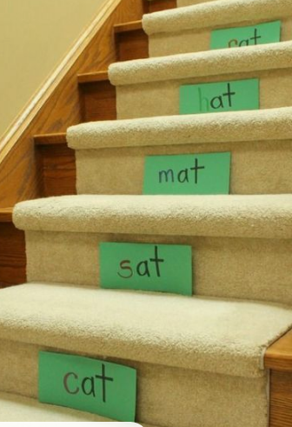
Leave word cards around the house as a challenge – can children read them as they head up the stairs to bed?

Slide 25
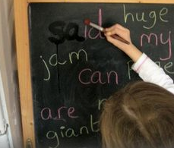
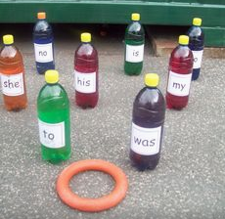
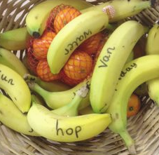
Stomp – lay the cards out on the floor and ask your child to ‘stomp’ on a chosen word.
Hide and Seek – hide your tricky words around the room and ask your child to hunt for them.
Shuffle your cards and make sentences using the words.
Bingo – write 6 words out on a piece of paper and call out words from the cards – ask your child to cross them out as you call them.
Pairs – make copies, lay the cards out face down and find matching pairs.
Snap – give your child two or three tricky word cards and ask them to hold them up when they hear them as you read a story.
Use the computer to write out the tricky words.
How many tricky words can you read in 1 minute?/2 minutes? Can you beat mummy and daddy?

Slide 26
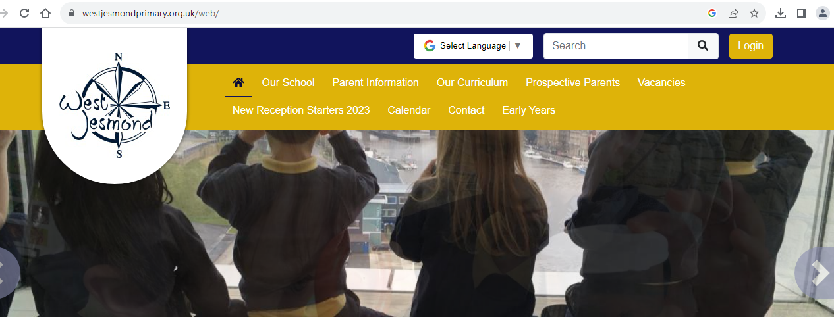
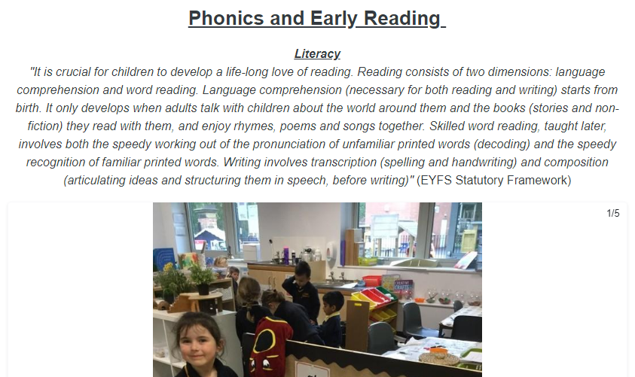

Slide 27
Thank you Dates for your diary Phonics workshop in class – 9-10 R1 – Tuesday 11th November R2 – Thursday 13th November R3 – Wednesday 12th November

