Slide 1
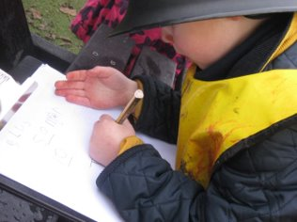
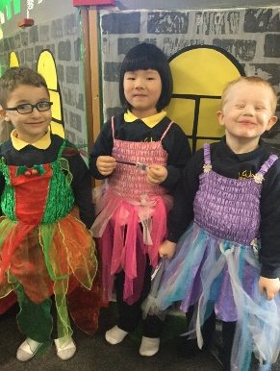
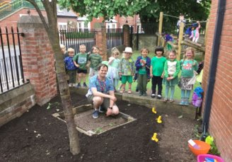
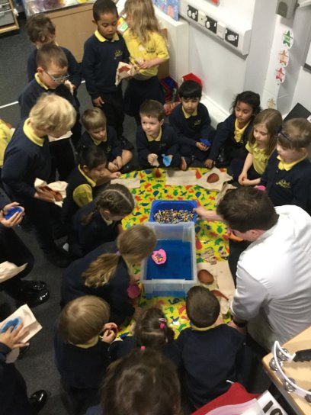
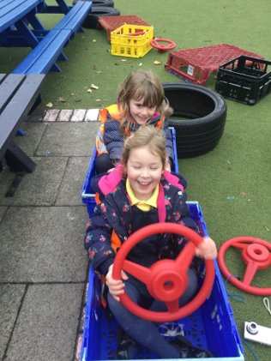
Welcome to Reception

Slide 2
Welcome to Reception
Our aims for this meeting:
Meet the Teachers
Starting school - Part time and Full time period
General information
Dates for your diary
What happens now; Getting ready for September

Slide 3
Starting School - Part-Time Period Tuesday 2nd September – Thursday 11th September
If your child is in Group 1 they will attend school in a group of 15 for the full day on the dates:
Week 1;
Tuesday 2nd September
Wednesday 3rd September
Week 2;
Monday 8th September
Tuesday 9th September
If your child is in Group 2 and they will
attend school in a group of 15 for the
full day on the dates:
Week1;
Thursday 4th September
Friday 5th September
Week 2;
Wednesday 10th September
Thursday 11th September
From Friday 12th September, all children will be full time.

Slide 4
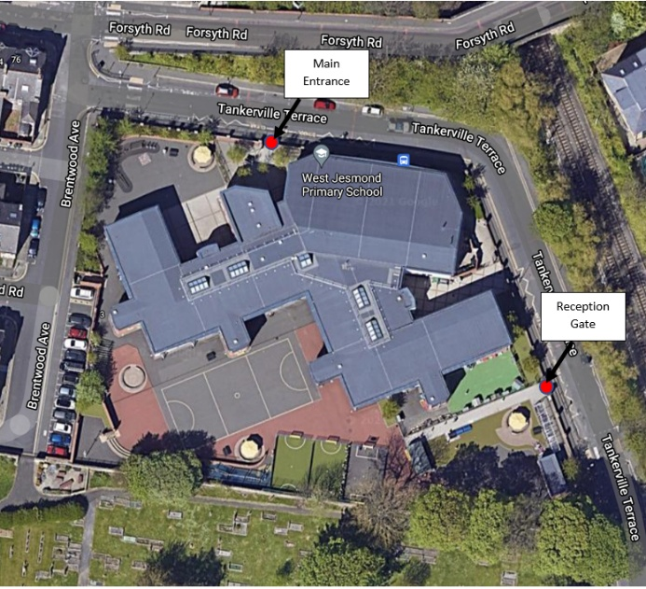
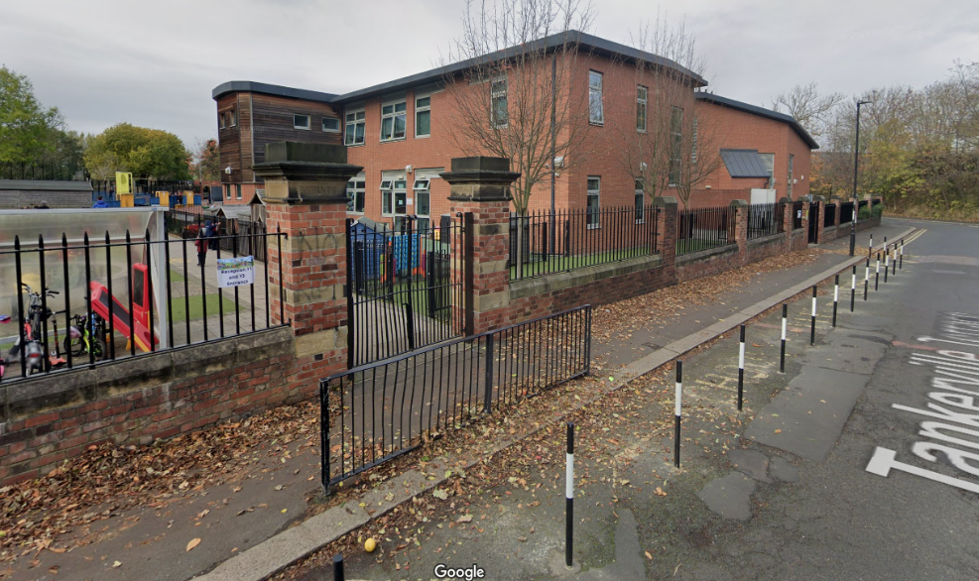
The School Day
The Start of the School Day
When you arrive at school, please line up on your allocated class spot.
At 8.45am classroom doors will open ready for school to start.
The End of the School Day
The Reception school day ends at 3:15pm. Please wait on your allocated class spot until teachers open the glass classroom door.
Reception class line-up points
Reception Main Gates

Slide 5
What will happen on the first day?
Teachers will stand at the classroom door to welcome you and your child into school.
On the first day, we would be happy to welcome one adult to come into school with their child to help them find their peg, their drawer and settle into their new classroom.
Children can hang up their coat and put their water bottle near the sinks.
We will give your child a name sticker to wear for the first morning.
The Teaching Assistants for each class will be there to help and support your child feel at home and find something to play with.
Once your child is settled, adults can give a kiss and cuddle and leave either through the main exit, or the Reception gates.
If your child is upset, please know we will reassure, comfort and settle them.
Often, they are fine once you have reached the school gate and often settle quicker without their grown up.
Once all the children are settled, we will gather the children together on the carpet and begin our first school day!
From the second day, if your child can manage, we would like to then encourage children to come into class by themselves. Families can walk their child to the class door, give a kiss and cuddle and say goodbye. Teachers and Teaching Assistants will then help the children settle into their day.

Slide 6
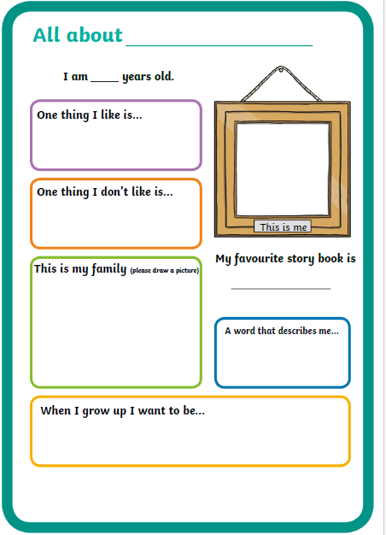
What will children need on their first day
Full school uniform
Named water bottle (please fill it up at home)
Change of clothes in a draw-string bag to leave on their peg (including socks and underwear)
All About Me poster
Packed lunch if they are not having school dinner

Slide 7
General Information

Slide 8
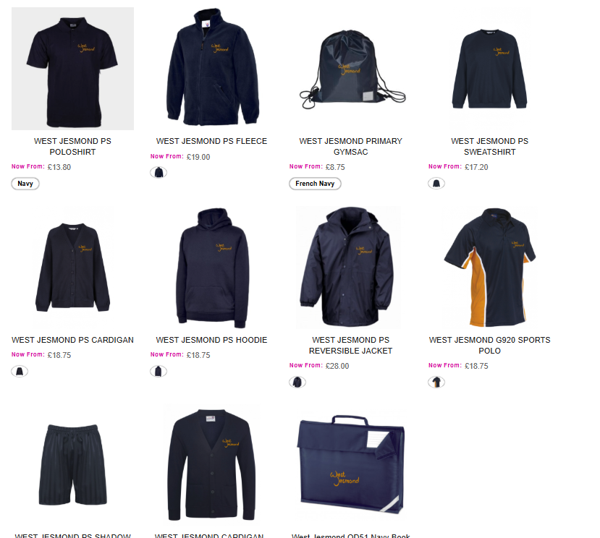
School Uniform
All school uniform can be purchased from: www.border-embroideries.co.uk
School uniform – Please ensure it is clearly labelled
General Uniform
Navy blue sweatshirt or cardigan
Yellow or navy blue polo shirt with or without the school logo
Navy blue trousers, skirts or shorts
Blue or yellow check-patterned dress
Plain black footwear
Coats and fleeces are also available from our supplier at parents own discretion. Fleeces should only be worn as outside clothing.
PE Kit
Navy blue jogging bottom or shorts
School branded blue/white/orange PE top or own plain navy blue t-shirt
Navy blue hoodie or navy blue hoodie with logo
Trainers (not ones worn for school on other days)
Come to school dressed in their PE kit on allocated days
Will need to wear their PE kit from the 3rd week of term

Slide 9
Book Bags
‘The Friends of West Jesmond’ will provide a bag for your child when they start school in September.
We will name and label these and have them ready for your child’s first day at school.
It will be stored in your child’s drawer throughout the day.
What should we use the bag for?
The Home School Reading Record & Reading book
Sound Cards & Helpful Word Folder
Any pieces of work or artwork between school and home.
Please note: Rucksacks or backpacks are too big to store in the class. Please only very small keyrings on bags, or they will not fit in the drawers.

Slide 10
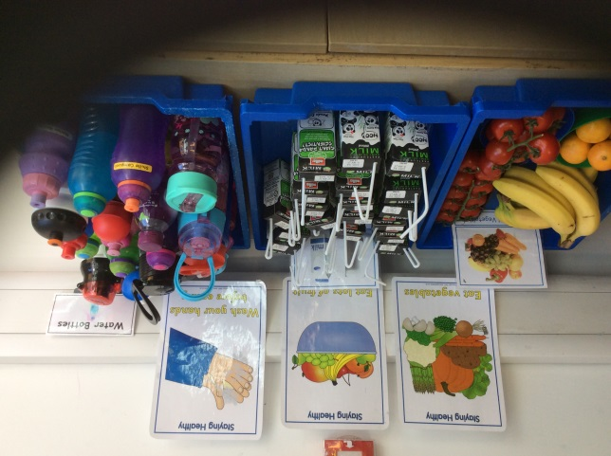
Milk & Water
Water Bottles
Your child will need a plastic water bottle with a sports top – clearly named. Easily identifiable water bottles will help your child find theirs amongst the 30!
The bottle will be sent home each night to be washed and refilled.
Milk
Milk is available for all children
Parents need to sign up via the Cool Milk website –
www.coolmilk.com
Children under the age of 5 receive milk free of charge.
Children over the age of 5 – You will need to ensure you pay for the milk, they will no longer receive one for free!
If your child is eligible for free school meals through Newcastle City Council, school pays for your child’s milk.
Please inform Cool Milk so they can verify with school

Slide 11
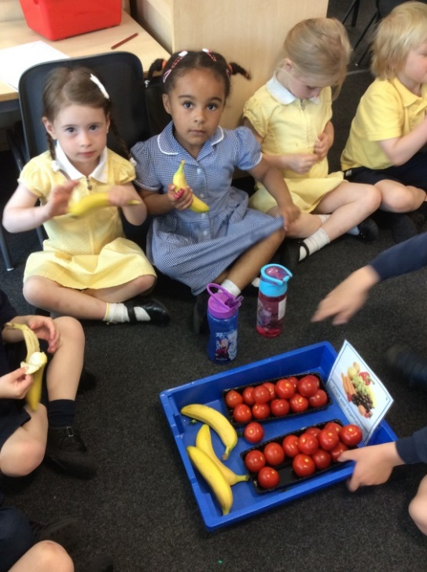
Healthy Snack
Your child will be provided with a piece of fruit/vegetables each day.
Please ensure that you have filled in the Fruit Scheme letter saying you would like them to have a piece of free fruit. This will be coming through via Weduc
Please inform us if your child has an allergy to any fruit or vegetable and we will ensure they do not eat anything they should not.
Please ensure any forms regarding allergies are returned to the office before September

Slide 12
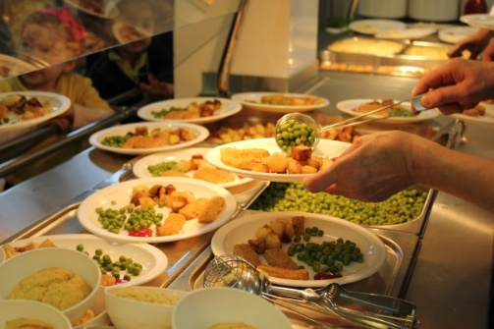
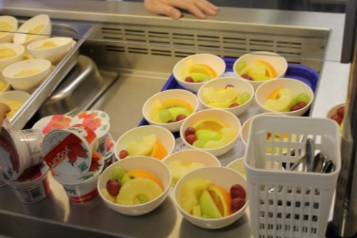
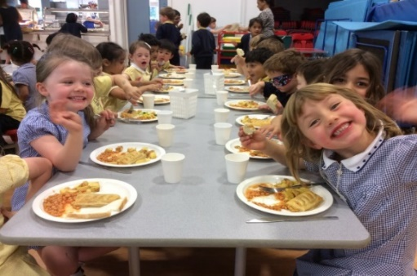
Lunchtime
Children in years Reception to Year 2 receive a ‘Universal Free School Meal’ – no payments are required by parents
There are 4-6 options each day.
Each day there is an option for both meat eaters and vegetarians. There is also a Halal option.
In your pack you will find information on how to sign up to our I-pay system so you can choose your child’ s lunch at home. This means you can help the children pick meals they will enjoy, and have a say in ensuring they try lots of different things.
Your child will choose a pudding on the day after they have finished their lunch – there is a choice of fruit on everyday
A drink of water will be provided
The school system will filter lunches for any allergies
Menus are available to view online via the school website
If your child does not want a school lunch, they can bring a packed lunch
Please do not give any products containing
nuts to your child

Slide 13
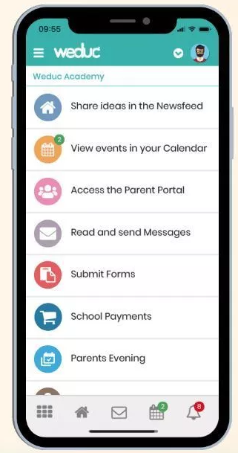
Weduc App
Weduc is an online payment and communication system
Make online payments 24 hours a day, 7 days a week
Payments are secure and funds will reach school safely
Communication - All newsletters and information are sent via Weduc
Parents are signed up automatically using your email address from admissions.
Please make sure you are successfully logged onto Weduc before starting school – all communication will come through this. Speak to the office team for help and support.

Slide 14
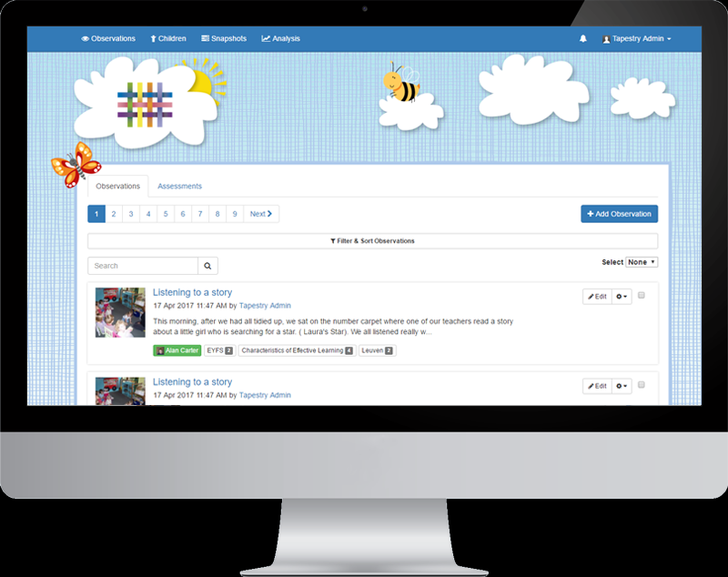
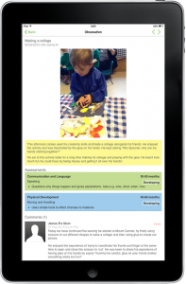
Tapestry
In Reception we use Tapestry as our online Learning Journal. It is a lovely way of recording your child’s life in Reception and staff will add observations from time to time. Families can be linked to their child’s Tapestry account and login to see photos and videos. You can also add your own observations to let us know about the lovely things you do at home.
You will automatically be signed up for Tapestry and will receive an activation email in September to set up your login and passwords.

Slide 15
Administration of Medication
If your child requires medication :
Please try to organise doses to be taken outside of school hours.
It is school policy not to administer medication, other than in exceptional circumstances.
If your child does require medication in school: (Cream, Inhaler, EpiPen)
Please contact the office to arrange a meeting.
We will arrange for you to drop off any medication and complete the relevant paperwork before the start of school in September.
If your child has a health condition, allergy, etc, please make sure you have let us know (you may have already completed this information on your registration forms)

Slide 16
Breakfast & After School Clubs
On-site - We have our very own Breakfast & After School Club
The clubs are always in high demand and may have a waiting list.
If you are interested in a space for your child, please contact the school office:
0191 2810000
Please provide details of the days and times you would need for your child.
Breakfast club;
Monday-Friday 8.00am-8.45 am
(breakfast included)
After School Club;
Monday – Friday 3.20pm – 5.55pm
(food included)

Slide 17
Clubs

Slide 18
What happens now? Getting ready for September

Slide 19
Class Visits
R1 – Group 1: Friday 27th June 1.30pm-2.45pm
Group 2: Thursday 10th July 1.30pm – 2.45pm
R2 - Group 1: Thursday 26th June1.30pm – 2.45pm
Group 2: Tuesday 8th July 1.30pm – 2.45pm
R3 – Group 1: Tuesday 24th June 1.30pm – 2.45pm
Group 2: Monday 7th July 1.30pm-2.45pm
On the day of your visit, please come to school via the main office where a member of the Reception team will come and meet you at 1.30pm to take you along to your class. If you are unable to attend your allocated day, please let us know and we can hopefully make a change of date.

Slide 20
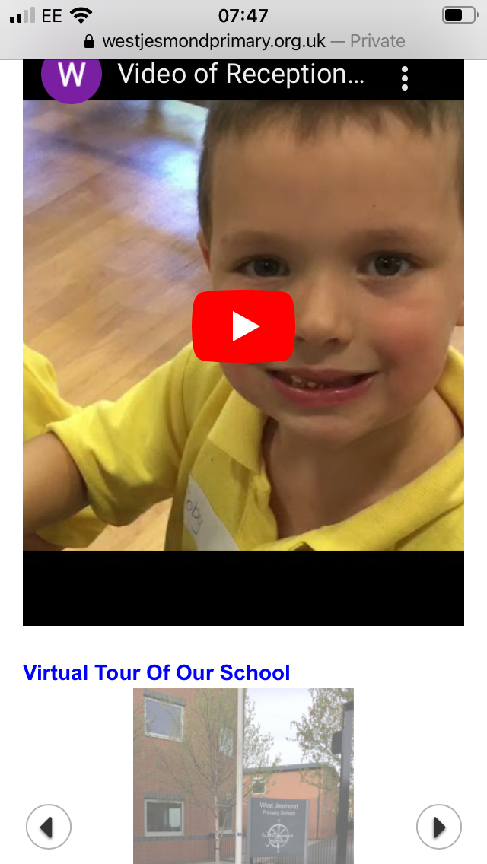
Support already available
Completing the forms sent via Weduc
Visiting our school website;
https://www.westjesmondprimary.org.uk

Slide 21
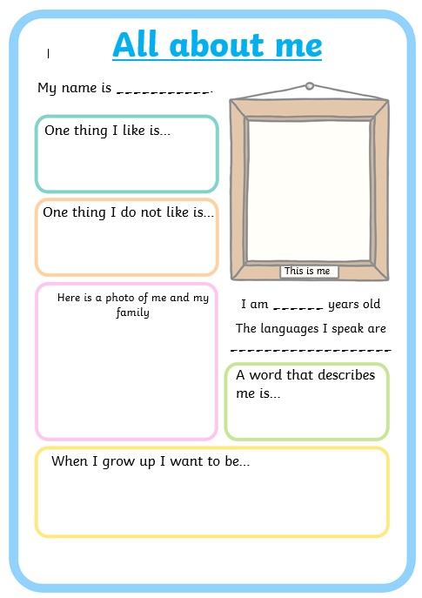
All About Me Poster
You will find a copy of the
‘All About Me Poster’ in your
information pack.
Please complete it with your child and return to the class teacher in
September.

Slide 22
Summer fair

Slide 24
Being ‘Ready for School’

Slide 25
Thank You
All of the information from today is included in your welcome pack – please keep it for future reference.
The slideshow will be added to the New Starters page on the school website.
Any questions please do not hesitate to get in touch.

